Slide 1
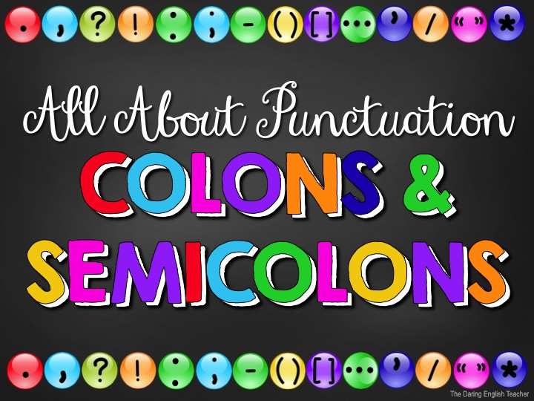

Slide 2
Punctuation
When we talk, we naturally pause and speak with intonation to communicate effectively.
When we write, we need to use punctuation to show these pauses and intonations.

Slide 3
Why Punctuate?
Using punctuation is important because it…
helps your writing flow.
increases the readers’ comprehension.
improves readability.
provides pauses.
conveys messages correctly.
If you punctuate incorrectly, you might write something with an entirely different meaning.

Slide 4
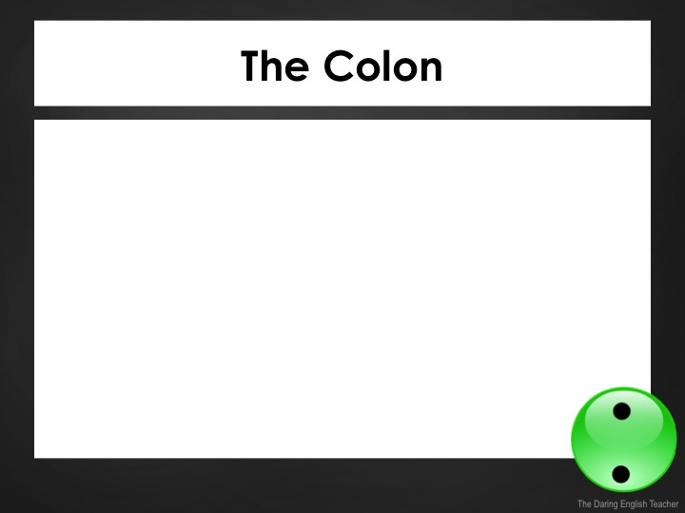
The Colon
The colon is a punctuation mark used to punctuate a major division in a sentence.
Colons should always come after independent clauses.
An independent clause is a complete sentence.

Slide 5
The Colon Rule 1
Use a colon to introduce a series of items.
Example:
I am taking three classes: geography, history, and philosophy.
Do not capitalize the first item after the colon unless it is a proper noun.
The first part of the sentence must be a complete sentence to use a colon.

Slide 6
The Colon Rule 1
Correct:
The band toured in three cities: Los Angeles, Pittsburg, and Charlotte.
Incorrect:
The band toured in Los Angeles, Pittsburg, and Charlotte.

Slide 7
The Colon Rule 1
Correct:
I went to the mall and purchased some new things: a pair of shoes, a pair of pants, and a shirt.
Incorrect:
I went to the mall and purchased: shoes, pants, and a shirt.

Slide 8
The Colon Rule 2
Use a colon to separate two clauses and to emphasize a phrase or single word at the end of a sentence.
Examples:
Only one word can describe this weekend: amazing.
That was the best roller coaster ever: it was awesome.

Slide 9
The Colon Rule 2
Correct
It was the best vacation ever: they went to a fancy resort on a tropical island.
Incorrect
It was the best vacation ever, they went to a fancy resort on a tropical island.

Slide 10
The Colon Rule 2
Correct
Only one word can describe the pizza we ordered last night: amazing.
Incorrect
Only one word can describe the pizza we ordered last night, amazing.

Slide 11
The Colon Rule 3
Use a colon to separate hours and minutes.
Examples:
The recital will start at 3:45.
I woke up at 6:15 this morning.

Slide 12
The Colon Rule 4
Use a colon to show a ratio.
Examples:
The oil and water should be mixed at a 1:2 ratio.
Mix the cinnamon and sugar at a 1:5 ratio.

Slide 13
The Colon Rule 5
Use a colon to set apart a quote from an independent clause.
Example:
My favorite quote is from William Shakespeare: “To thine own self be true.”
Notice: The text before the colon is an independent clause (complete sentence) and can stand alone, so use a colon for the quote.

Slide 14
The Colon Rule 5
Correct
Abraham Lincoln once said something that really resonated with me: “Whatever you are, be a good one.”
Incorrect
Abraham Lincoln once said: “Whatever you are, be a good one.”

Slide 15
The Colon Rule 6
Use a colon after a formal salutation in a letter.
Example:
To Whom it May Concern:
Dear John Smith:

Slide 16
Where does the colon go?
I need to go to the gas station the tank is on empty.
:

Slide 17
Where does the colon go?
Annie’s singing is stuck in my head “The sun will come out tomorrow!”
:

Slide 18
Where does the colon go?
School is usually dismissed at 3 15 in the afternoon.
:

Slide 19
Where does the colon go?
The day could not get any worse it was just awful.
:

Slide 20
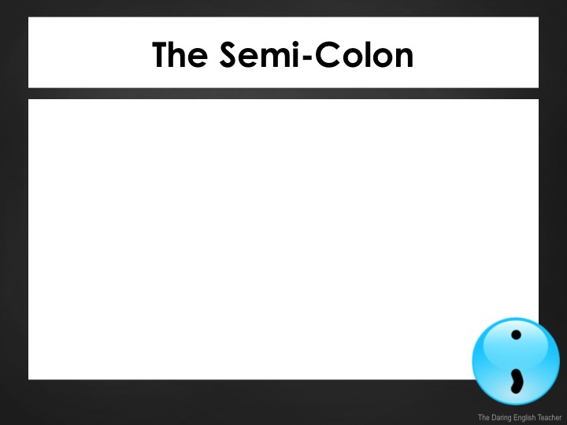
The Semicolon
The semicolon is a punctuation mark used to separate major sentence elements.
The semicolon has 3 uses and rules:
Combining independent clauses
Combining independent clauses with a conjunctive adverb
Separating items in an intricate list

Slide 21
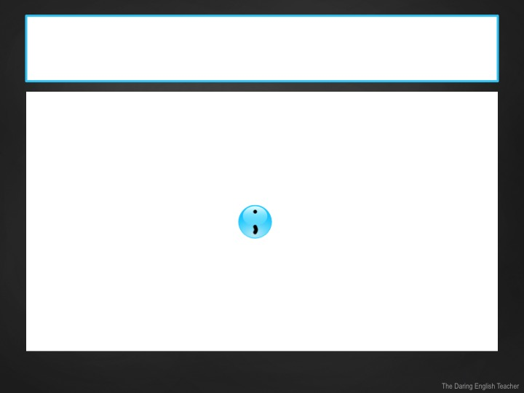
The Semicolon Rule 1
Use the semicolon to connect two closely related independent clauses.
An independent clause is a complete sentence.
Example:
Independent clause + + independent clause.
Her sister is a competitive gymnast; she won the silver medal in the meet.

Slide 22
The Semicolon Rule 1
Rule 1 Examples:
The young toddler was crying in the store; he was tired and hungry.
A teacher handed out a pop quiz; students were not ready for it.
Five jets looped in unison in the sky;
they were an aerial stunt team.

Slide 23
The Semicolon Rule 1
Correct
Just like every other day, the ferry left the dock at 7:30 in the evening; it was very predictable.
Incorrect
Just like every other day; the ferry left the dock at 7:30 in the evening.

Slide 24
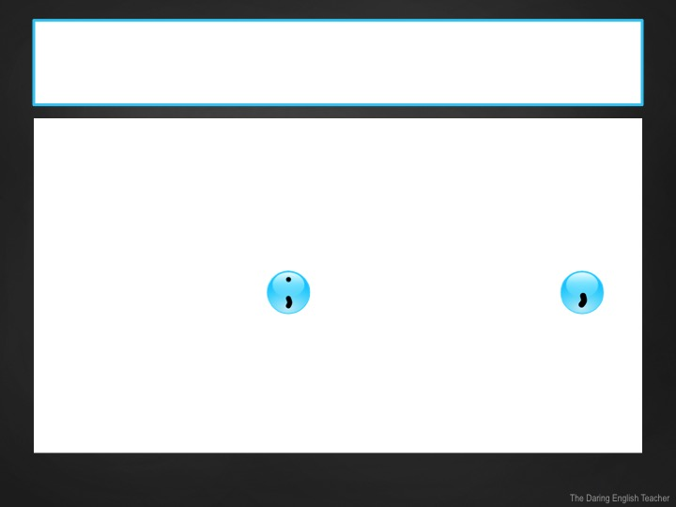
The Semicolon Rule 2
Use the semicolon with a conjunctive adverb to connect two closely related independent clauses.
An independent clause is a complete sentence.
Example:
Independent clause + + conjunctive adverb + + independent clause.
Her sister is a competitive gymnast; however, she sprained her ankle and could not compete today.

Slide 25
The Semicolon Rule 2
Rule 2 Examples:
I want to play soccer; however, I am not athletic.
Sam and Carla are studying for the SAT; likewise, Gina and Carlos are too.
She forgot to put the milk away;
therefore, it went bad.

Slide 26
The Semicolon Rule 2
Correct
It is raining in Seattle, Washington; whereas, it is sunny in Newport Beach, California.
Incorrect
It is raining in Seattle, Washington, whereas; it is sunny in Newport Beach, California.

Slide 27
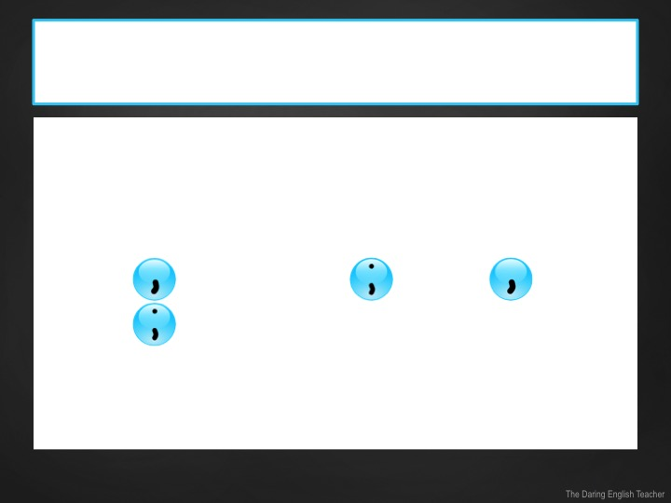
The Semicolon Rule 3
Use the semicolon to help separate items in an intricate list.
An independent clause is a complete sentence.
Example:
…item + + more details + + item + + more details + [repeat].
Her gymnast sister competed in Las Vegas, Nevada; Tucson, Arizona; and Bellevue, Washington.

Slide 28
The Semicolon Rule 3
Rule 3 Examples:
There are a lot of doctors in my family including my father, a pediatrician; my mother, a neurosurgeon; my aunt, a cardiologist; and my older brother, an oncologist.
I want to visit Lima, Peru; Paris, France; and Tokyo, Japan.

Slide 29
The Semicolon Rule 3
Correct
It is raining in Seattle, Washington; Newport Beach, California; and Carson City, Nevada.
Incorrect
It is raining in Seattle, Washington, Newport Beach, California, and Carson City, Nevada.

Slide 30
Where does the semicolon go?
;
I like dogs however, I hate the way they smell.

Slide 31
Where does the semicolon go?
;
The barn is really small only one tractor fits inside it.

Slide 32
Where does the semicolon go?
My family is filled with artists. There is my sister, who is a pianist my brother, who is a sculptor and my mother, who is a painter.
;
;

